Slide 1

Zomato Restaurants Analysis
By vishal kumar

Slide 2

Launched in 2010, Zomato is one of the most comprehensive and user-friendly apps for finding nearby restaurants and cafés to dine in or to order food online. It also gives menus, reviews, and ratings to acquire factual information on eateries.

Slide 3
Agenda
1.Problem Statement
2.Data Description
3.Objective key metrics and visualization
4.Insights From subjective question
5.Stratergic Recommendation and dashboard

Slide 4
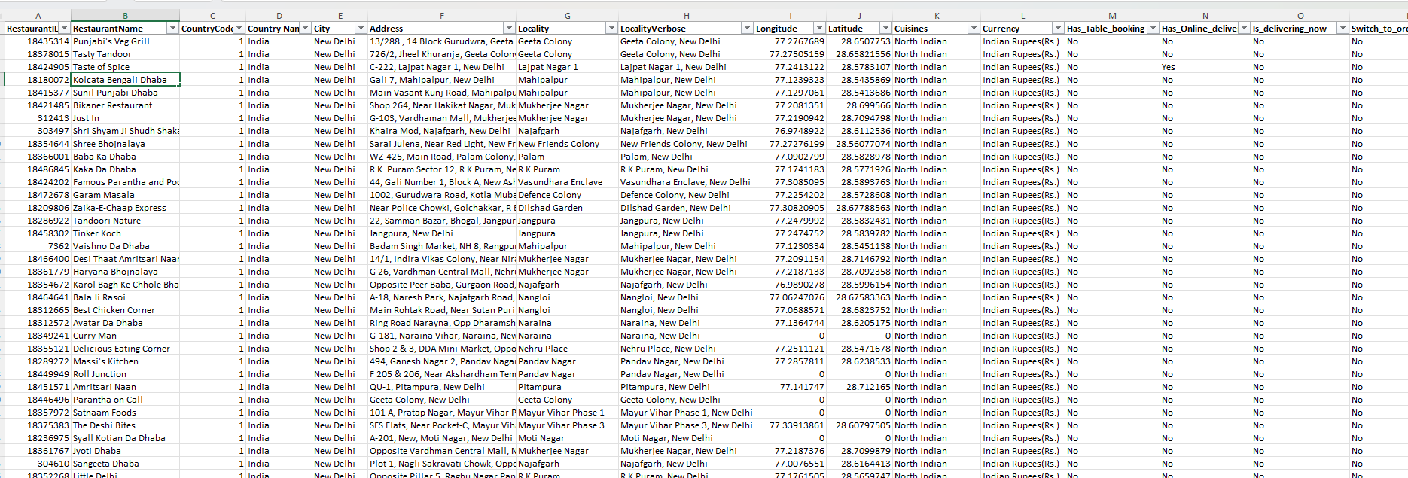
Problem Statement
You are hired as a consultant data analyst by Zomato where the team is looking for expansion and opening more restaurants. Your task is to develop strategies/suggestions for opening newer restaurants.

Slide 5
Zomato Marketplace Data
RestaurantID: Unique identifier for each restaurant.
RestaurantName: Name of the restaurant.
CountryCode: Code representing the country of the restaurant.
City: City where the restaurant is located.
Rating: Restaurant rating based on customer feedback.
·Datekey_Opening: Opening date of the restaurant in the format YYYY_MM_DD.
Country Code: Contains The code assigned to the Countries
Country Name: Contains name of each country
Address: Full address of the restaurant.
Locality: Local area or neighbourhood of the restaurant.
LocalityVerbose: Detailed description of the locality.
Longitude: Geographical longitude of the restaurant.
Latitude: Geographical latitude of the restaurant
.
Cuisines: Type of cuisines offered by the restaurant.
Currency: Currency used for transactions at the restaurant.
Average_Cost_for_two: Average cost for two people dining at the restaurant.
Has_Table_booking: Indicates whether the restaurant offers table booking (Yes/No).
Has_Online_delivery: Indicates if the restaurant provides online delivery (Yes/No).
Is_delivering_now: Indicates whether the restaurant is delivering at the current time (Yes/No).
Switch_to_order_menu: Indicates if the menu is switched to an order-based menu (Yes/No).
Price_range: Price category of the restaurant, on a scale from low to high.
Votes: Number of votes received by the restaurant.

Slide 6
Methodology
Data Cleaning: Removed null and empty values which could hamper our analysis, such as in some places “cuisines” cell was empty.
Data Enrichment: Added in the dataset with additional variables like VLOOKUP to cross reference country.
Descriptive: Described Various Data Through Pivot tables
Competitor Analysis: Restaurants Wise Analysis in Different Suggested Countries
Visualization: Used Different Charts to Create Dashboard.

Slide 7
Number of Restaurants opened in each Country
India Has the Highest number of Restaurants which is 8652
It is followed by USA which has 425 restaurants
Singapore, Qatar and Canada, Sri Lanka has the lowest no. Of restaurants

Slide 8
Restaurants opened each year
This line chart has restaurants which are opened each year in suggested countries
Growth peaked in 2013 with 10 openings.
Declined to 6 in 2014, recovered to 7 in 2016.
Dropped to 5 from 2017 onwards.
Indicates market saturation or shifts.
Innovation needed for a successful launch.

Slide 9
No. of Restaurants vs Average Rating
The number of restaurants and their ratings were the key metrics used to determine the best locations for opening new restaurants.
Small number of restaurants would reduce competition and provide a good foundation for new restaurants.
Lower-average ratings would indicate the need for better services and quality.
Canada, Qatar, Singapore and Sri Lanka are suggested for new restaurant openings.

Slide 10
Average cost for two
Helps to understand spending limit of people
Singapore has higher spending limit
Qatar and Canada have mid range spending limit.
Sri lanka has the lowest spending limit

Slide 11
Table booking and Online Delivery
A significant portion of restaurants are missing out on key digital services. Nearly half (45%) do not offer table bookings, and a similar proportion (46%) lack online delivery options. Our data indicates that restaurants with these features tend to receive higher ratings.

Slide 12
Top cuisines
North Indian has the highest votes as it the most popular cuisine
Chinese and fast food are also popular
We can give emphasis on these cuisines in new restaurants to get high revenue

Slide 13
Price Range Distribution
Price Sensitivity: Market analysis reveals customer preference for affordable dining.
Dominant Range: Most restaurants fall within the 1-2 price bracket.
Mass Appeal: Restaurants in the 1-2 range cater to a large customer base.
Niche Opportunity: Less competition exists in the 3-4 price range.
Strategic Pricing: Targeting the 1-2 segment maximizes customer reach.

Slide 14
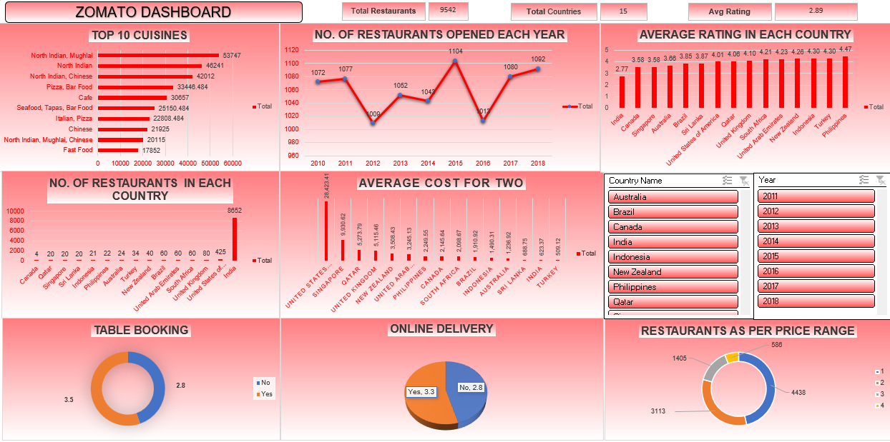
Dashboard

Slide 15
Recommendations
Suggested Markets for New Restaurant Ventures:
Canada
Qatar
Singapore
Sri Lanka
These countries present attractive opportunities due to a relatively lower number of restaurants and modest average ratings, signaling reduced competition. Focusing on enhancing food quality and service can improve customer satisfaction and drive higher ratings.
Canada-Specific Insights:
Target Cities: Consort and Yorkton have average ratings below 4.0, making them prime locations for opening restaurants that prioritize superior dining experiences to gain a competitive edge.
Market Gap: With only four restaurants in Canada averaging an expenditure of 3081 INR per visit, the limited competition offers significant growth potential.

Slide 16
Recommendations
Cuisine Opportunity: Chinese and Canadian cuisines are currently rated low. Providing authentic Chinese cuisine with an exceptional dining experience could help capture a niche market.
Service Features: Restaurants offering online delivery and table booking tend to perform better in terms of ratings. Including these services would be a strategic advantage.
Pricing Strategy: Establishing restaurants within the 1–2 pricing category could help attract a broad customer base, as this price range covers a majority of the market demand.
This focused approach can position your brand for long-term success in these untapped regions.

Slide 17
Conclusion
Elevate Customer Experience & Ratings
Restaurants offering online ordering and reservations consistently achieve higher customer satisfaction and ratings.
Prioritizing these digital amenities is crucial for all new restaurant ventures.
Strategic Expansion Opportunities
Untapped market potential exists in areas with fewer dining establishments.
Locations with lower average ratings present opportunities for quality improvement and market share capture.
Canada, Qatar, Singapore, and Sri Lanka offer particularly promising environments for new restaurant development.
Targeted Pricing Strategies
Analyzing average spending per customer informs effective pricing models.
Canada presents a balanced market with moderate spending and less competitive pressure.
Singapore caters to a higher-end clientele, offering potential for premium pricing.
Optimized Price Point Positioning
Appealing to a broad audience requires focusing on the ₹1-2 price range.
The ₹3-4 price segment offers niche market potential with reduced competition.

Slide 18
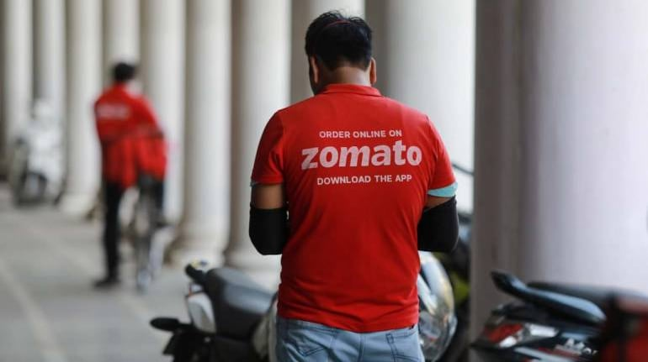
Thank-you

